Slide 1
Dynamic Asset Management – Update May 2018

Slide 2
Approach
Update daily asset price data
Use barchart.com (free API) with Excel/VBA
Screen updated asset price data to identify top candidates for next investment period.
Use PowerBI, R, Rstudio for screening and evaluation.
Should consider various methods to estimate *future* return, not just rely on historical returns of various periods
Current code allows using different lengths of samples for Expected Returns, and for calculating Asset Covariances
Calculate efficient frontiers (shorting and no-shorting), including:
Portfolios along the efficient frontiers,
Maximum Sharpe ratio points and corresponding portfolios
Use R / Rstudio to solve for points/portfolios on an efficient frontier
Repeat screening and calculating frontiers until happy.

Slide 3
Example 1: 2000-2016 Monthly Price Data for IBM, JPM, GOOG
Data from: ??
Parameters:
12 samples (1 year) for expected return
60 samples (5 years) for covariance
Screening (so far):
Relative Price chart – indexed to most recent data value
Return / Risk chart of individual assets
Correlation heatmap – (still a work in progress)
Efficient Frontiers and Portfolios
Two cases: “Shorting Allowed” and “No Shorting”
Code allows using different lengths of samples for Expected Returns, and for calculating Asset Covariances

Slide 4
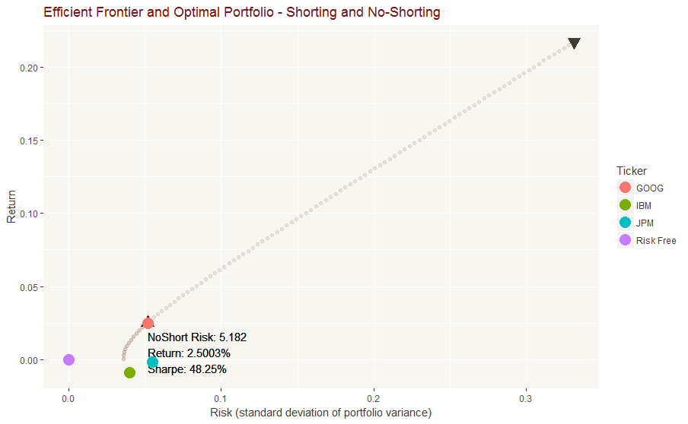
Example 1: Charts

Slide 5
Example 1: Charts

Slide 6
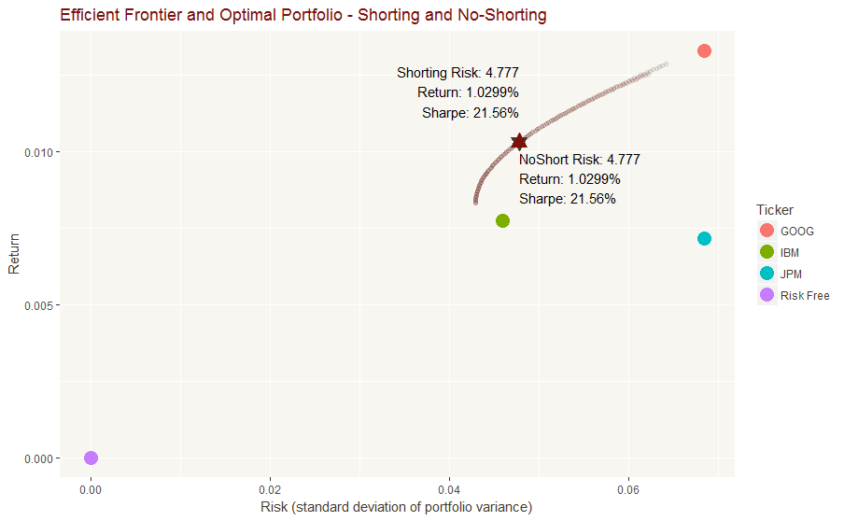
Example 2 – same data – 10 yrs/10yrs

Slide 7
Example 2 – same data – 10 yrs/10yrs

Slide 8
Software needed
Excel / VBA: used to download data from barchart.com
R: language for data analysis and stats - https://www.r-project.org/
Rstudio: development environment for R - https://www.rstudio.com/products/rstudio/download/
PowerBI desktop: eventually to be used for screening - https://powerbi.microsoft.com/en-us/downloads/

Slide 9
Additional Functionality Needed
Quickly screen and down-select the pool of assets
Quickly evaluation different frontiers and adjust range of analysis parameters or step increments (risk increment, max risk)
Alternative estimates of future return
Evaluate approaches with accuracy & bias of 1 month (or 1 refresh period) future forecast.
Evaluate stability and range of covariance between selected pairs.
Better graphical summary of max Sharpe portfolios
Calculate rebalancing trades needed from current portfolio to selected future portfolio weights.
Confirm if fewer assets makes more stable frontiers/portfolios, or if numerical calculations are so stable they don’t care. This will shape how much manual ‘screening’ and ‘down-selection’ is needed (vs. just ‘fun-to-do’)
Understand a little more about why certain assets were selected in the ‘many similar assets’ scenario.

Slide 10
Next Steps
Tim to download R, Rstudio.
Tom to share:
Excel/VBA file (cleaned-up version)
Rstudio project, with related scripts. Only include small sample data sets.

